Slide 1
Splash Screen

Slide 2
Lesson Menu
Five-Minute Check (over Lesson 5–1)
Then/Now
Example 1: Equations with Variables on Each Side
Example 2: Equations with Variables on Each Side
Example 3: Real-World Example: Solve Equations with Variables on Each Side

Slide 3
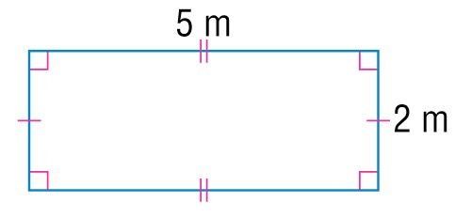
5-Minute Check 1
Find the perimeter and area of the figure.
A. P = 14 m; A = 10 m²
B. P = 10 m; A = 14 m²
C. P = 14 m; A = 14 m²
D. P = 10 m; A = 10 m²

Slide 4
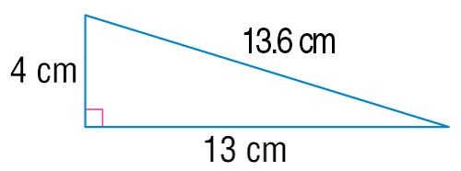
5-Minute Check 2
Find the perimeter and area of the figure.
A. P = 30.6 cm; A = 52 cm²
B. P = 30.6 cm; A = 26 cm²
C. P = 17 cm; A = 52 cm²
D. P = 17 cm; A = 26 cm²

Slide 5
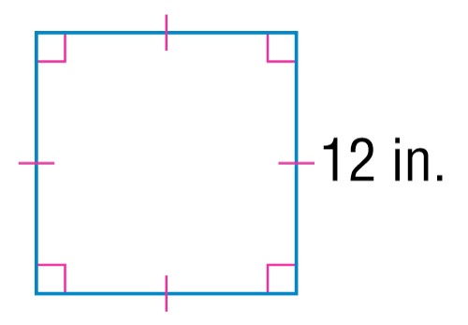
5-Minute Check 3
Find the perimeter and area of the figure.
A. P = 24 in.; A = 48 in²
B. P = 24 in.; A = 144 in²
C. P = 48 in.; A = 144 in²
D. P = 48 in.; A = 48 in²

Slide 6
5-Minute Check 4
The width of a rectangle is 7 meters and its length is 6 meters. Find its perimeter.
A. 44 m
B. 42 m
C. 28 m
D. 26 m

Slide 7
5-Minute Check 5
The height of a right triangle is 4 feet and the width of its base is 6 feet. Find its area.
A. 24 ft²
B. 12 ft²
C. 10 ft²
D. 6 ft²

Slide 8
5-Minute Check 6
What happens to the area of a rectangle if its width and length are tripled?
A. The area is the same.
B. The area is six times larger.
C. The area is three times larger.
D. The area is nine times larger.

Slide 9
Then/Now
You have already solved two-step equations. (Lesson 4–5)
Solve equations with variables on each side.
Solve equations that involve grouping symbols.

Slide 10
Example 1
Equations with Variables on Each Side
Solve 5x + 12 = 2x. Check your solution.
5x + 12 = 2x Write the equation.
5x – 5x + 12 = 2x – 5x Subtract 5x from each side.
12 = –3x Simplify.
–4 = x Mentally divide each side by –3.
Subtract 5x from the left side of the equation to isolate the variable.
Subtract 5x from the right side of the equation to keep it balanced.

Slide 11
Example 1
Equations with Variables on Each Side
To check your solution, replace x with –4 in the original equation.
Check 5x + 12 = 2x Write the equation.
?
5(–4) + 12 = 2(–4) Replace x with –4.
?
–20 + 12 = –8 Simplify.
–8 = –8 This statement is true.
✓
Answer: The solution is –4.

Slide 12
Example 1
Solve 7x = 5x + 6. Check your solution.
A. –3
B.
C. 3
D. 21

Slide 13
Example 2
Equations with Variables on Each Side
Solve 7x + 3 = 2x + 23.
7x + 3 = 2x + 23 Write the equation.
7x – 2x + 3 = 2x – 2x + 23 Subtract 2x from each side.
5x + 3 = 23 Simplify.
5x + 3 – 3 = 23 – 3 Subtract 3 from each side.
5x = 20 Simplify.
x = 4 Mentally divide each side by 5.
Answer: The solution is 4.

Slide 14
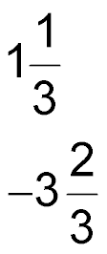
Example 2
Solve 4x + 15 = 2x – 7.
A.
B.
C. –11
D. –22

Slide 15
Example 3
Solve Equations with Variables on Each Side
CAR RENTAL A car rental agency has two plans. Under Plan A, a car rents for $80 plus $20 each day. Under Plan B, a car rents for $120 plus $15 each day. Write and solve an equation to determine for what number of days the costs of the two plans will be equal.

Slide 16
Example 3
Solve Equations with Variables on Each Side
80 + 20d = 120 + 15d Write the original equation.
80 + 20d – 80 = 120 + 15d – 80 Subtract 80 from each side.
20d = 40 + 15d Simplify.
20d – 15d = 40 + 15d – 15d Subtract 15d from each side.
5d = 40 Simplify.

Slide 17
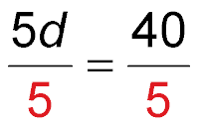
Example 3
Solve Equations with Variables on Each Side
Divide each side by 5.
d = 8 Simplify.
Answer: The costs would be equal after 8 days.

Slide 18
Example 3
CELL PHONES A cell phone provider offers two plans. Under Plan A, the monthly cost is $20 with a cost of $0.35 per minute. Under Plan B, the monthly cost is $35 with a cost of $0.15 per minute. What number of minutes results in the same cost?
A. 30 minutes
B. 75 minutes
C. 110 minutes
D. 275 minutes

Slide 19
End of the Lesson

